Slide 1
Applied Statistical Analysis
EDUC 6050
Week 5
Finding clarity using data

Slide 2
Today
Hypothesis Testing with Z Scores (continued)
Hypothesis Testing with t-tests (one sample, independent samples, and paired-samples)

Slide 3
Tests
Situation | Test to Use
Single Group: Know population mean and standard deviation | Z-Test
Single Group: Know population mean but not the standard deviation | One-Sample T-Test
Have two independent groups that you want to compare | Independent Samples T-Test
Have same individuals measured two times (or matched pairs) | Paired Samples T-Test (Dependent Samples T-Test)

Slide 4
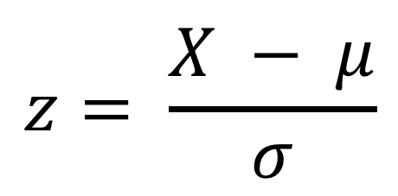
Z-Scores for an Individual Point
$$z= \frac{X − μ}{σ}$$
Tells us:
If the score is above or below the mean
How large (the magnitude) the deviation from the mean is to other data points
Notes:
What units are z scores in?
Standard deviation units

Slide 5
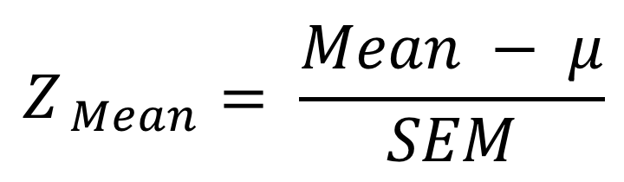
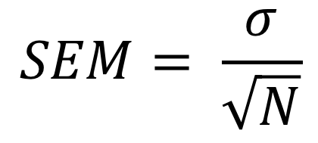
The Z for a Sample Mean
$$Z_{ Mean}= \frac{Mean − μ}{SEM}$$
$$SEM= \frac{σ}{\sqrt{N}}$$
Depends on sample size (bigger sample, smaller SEM)

Slide 6
Z-Score and the Standard Normal Curve
Appendix A shows more exact p-values
Notes:
This only works if the distribution of the raw scores are normally-distributed!

Slide 7

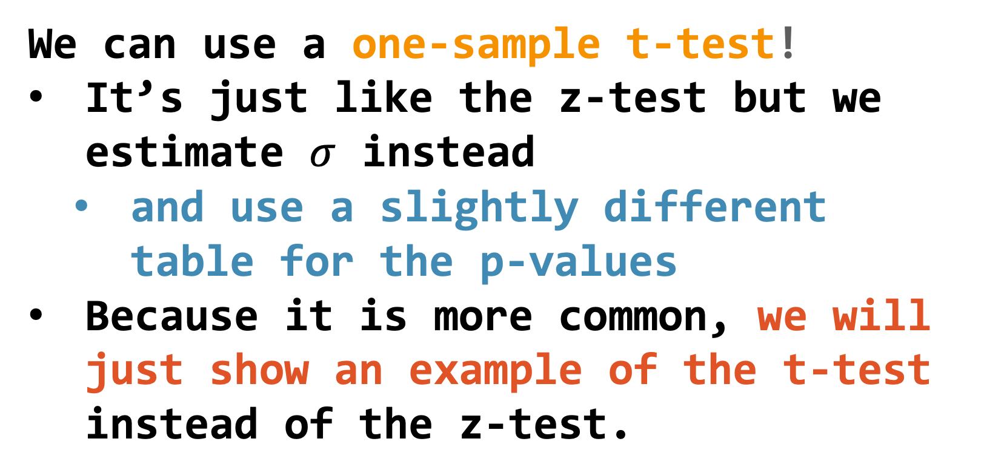
What if we don’t know $σ$ ??
We can use a one-sample t-test!
It’s just like the z-test but we estimate $σ$ instead
and use a slightly different table for the p-values
Because it is more common, we will just show an example of the t-test instead of the z-test.
Notes:
This only works if the distribution of the raw scores are normally-distributed!

Slide 8
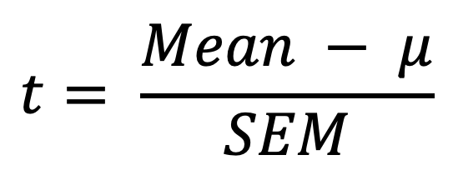
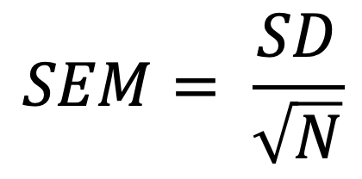
The One-Sample T-test
$$t= \frac{Mean − μ}{SEM}$$
$$SEM= \frac{SD}{\sqrt{N}}$$

Slide 9
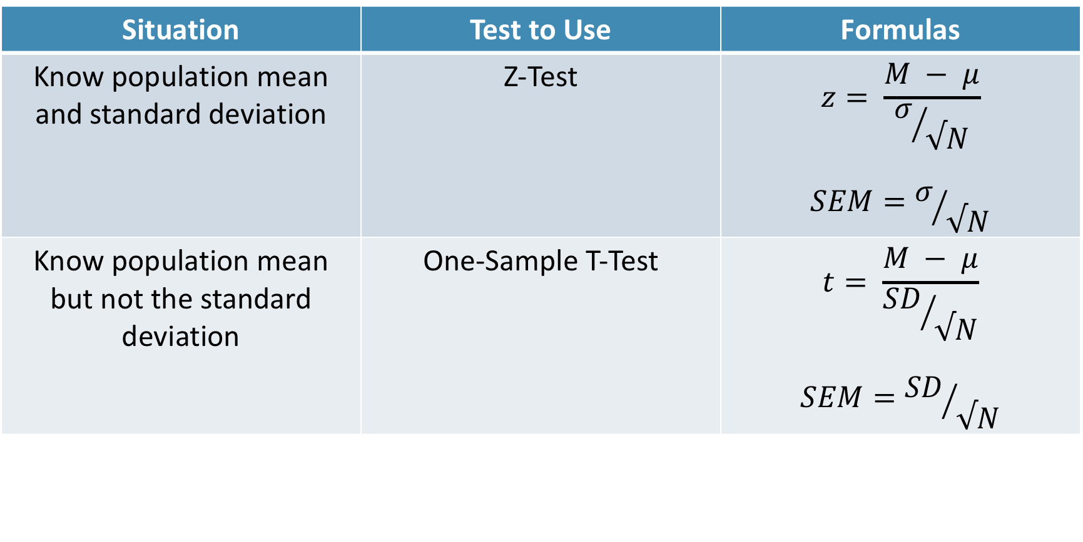
One-Sample T-test vs Z-test
Situation | Test to Use | Formulas
Know population mean and standard deviation | Z-Test | $$z= \frac{M − μ}{σ/{√N}}$$ $$SEM=σ/{√N}$$
Know population mean but not the standard deviation | One-Sample T-Test | $$t= \frac{M − μ}{{SD}/{√N}}$$ $$SEM={SD}/{√N}$$
Notes:
It’s rare to know the population SD so it is much more common to use the t-test. As such, that’s what we’ll focus on of the two.

Slide 10
Single-Sample T-tests
Requirements
Slightly different distribution
Need a DV on an interval/ratio scale,
IV defines one sample, and
you do not know the population standard deviation
Notes:
As your sample size increases, the t gets closer and closer to the normal distribution

Slide 11
Hypothesis Testing with T-Tests
The 6-step approach!
Examine Variables to Assess Statistical Assumptions
State the Null and Research Hypotheses (symbolically and verbally)
Define Critical Regions
Compute the Test Statistic
Compute an Effect Size and Describe it
Interpreting the results

Slide 12
Examine Variables to Assess Statistical Assumptions
1
Basic Assumptions
Independence of data
Appropriate measurement of variables for the analysis
Normality of distributions
Homogeneity of variance

Slide 13
Examine Variables to Assess Statistical Assumptions
1
Basic Assumptions
Independence of data
Appropriate measurement of variables for the analysis
Normality of distributions
Homogeneity of variance
Individuals are independent of each other (one person’s scores does not affect another’s)

Slide 14
Examine Variables to Assess Statistical Assumptions
1
Basic Assumptions
Independence of data
Appropriate measurement of variables for the analysis
Normality of distributions
Homogeneity of variance
Here we need interval/ratio DV and an IV that is for a single sample (group)
Notes:
For t-test, DV needs to be interval/ratio

Slide 15
Examine Variables to Assess Statistical Assumptions
1
Basic Assumptions
Independence of data
Appropriate measurement of variables for the analysis
Normality of distributions
Homogeneity of variance
The outcome needs to be normal (for small samples)

Slide 16
Examine Variables to Assess Statistical Assumptions
1
Basic Assumptions
Independence of data
Appropriate measurement of variables for the analysis
Normality of distributions
Homogeneity of variance
The variance of our sample is supposed to match the population variance (but do we know it?)

Slide 17
Examine Variables to Assess Statistical Assumptions
1
Examining the Basic Assumptions
Independence: random sample
Appropriate measurement: know what your variables are
Normality: Histograms, skew and kurtosis
Homogeneity: Hard to assess
Notes:
There are tests we can do but we won’t go into those now.

Slide 18
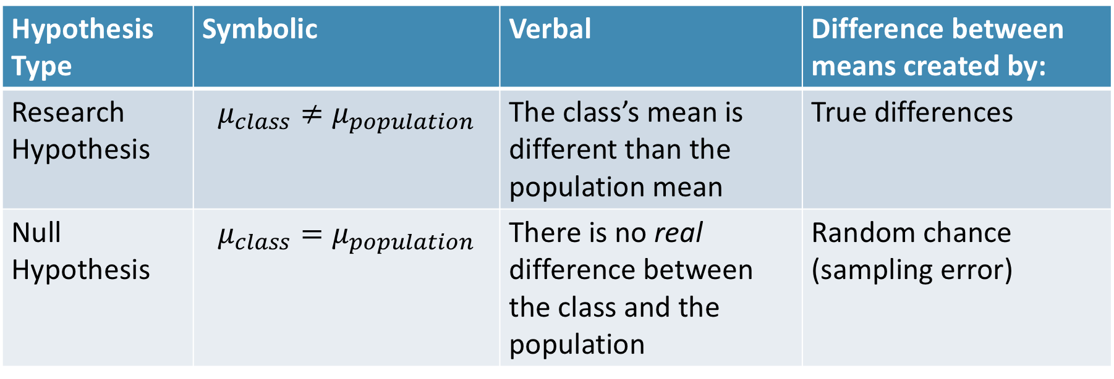
State the Null and Research Hypotheses (symbolically and verbally)
2
Hypothesis Type | Symbolic | Verbal | Difference between means created by:
Research Hypothesis | $$μ_{class}≠μ_{population}$$ | The class’s mean is different than the population mean | True differences
Null Hypothesis | $$μ_{class}=μ_{population}$$ | There is no real difference between the class and the population | Random chance (sampling error)
Notes:
Null and research hypotheses are mutually exclusive (they cover all possible outcomes)

Slide 19
Define Critical Regions
3
How much evidence is enough to believe the null is not true?
Before analyzing the data, we define the critical regions (generally based on an alpha = .05)

Slide 20
Define Critical Regions
3
We decide on an alpha level first
Then calculate the critical value (based on sample size)
Notes:
If our computed t-stat is beyond 1.96 OR our p-value is below .05, then we REJECT the null (the findings are statistically significant)

Slide 21

Define Critical Regions
3
We decide on an alpha level first
Then calculate the critical value (based on sample size)
I’ll provide a table for you for the t values
Base on alpha and a specific df
$$df=N −1$$
Notes:
If our computed t-stat is beyond 1.96 OR our p-value is below .05, then we REJECT the null (the findings are statistically significant)

Slide 22
Define Critical Regions
3
We decide on an alpha level first
Then calculate the critical value (based on sample size)
I’ll provide a table for you for the t values
Base on alpha and a specific df
$$df=N −1$$
Notes:
If our computed t-stat is beyond 1.96 OR our p-value is below .05, then we REJECT the null (the findings are statistically significant)

Slide 23


Define Critical Regions
3
We decide on an alpha level first
Then calculate the critical value (based on sample size)
$$t_{critical, 29}=2.05$$
So our critical regions is defined as:
$$α= .05$$
$$t_{critical, 29}=2.05$$
Notes:
If our computed z score is beyond 2.05 OR our p-value is below .05, then we REJECT the null (the findings are statistically significant)

Slide 24
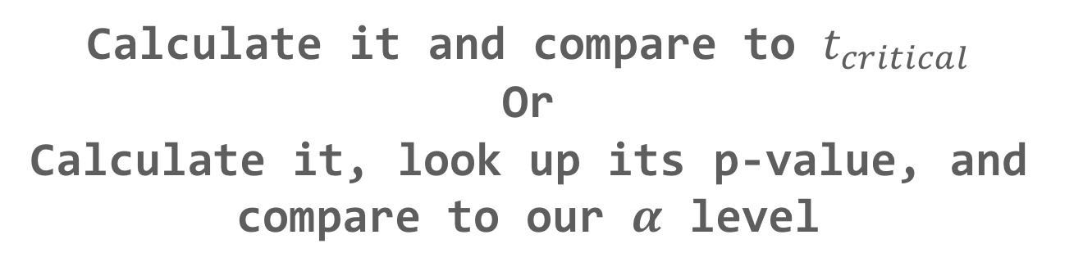
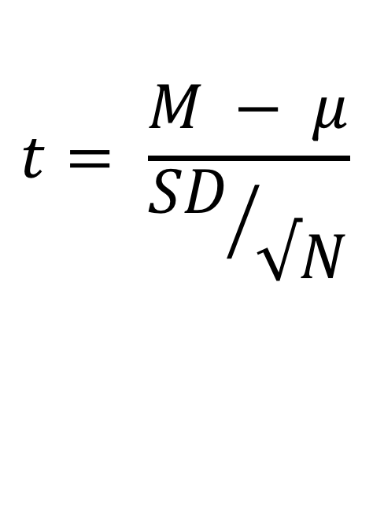
Compute the Test Statistic
4
$$t= \frac{M − μ}{{SD}/{√N}}$$
The SEM, $μ$, and M will be given to you
Calculate it and compare to $t_{critical}$
Or
Calculate it, look up its p-value, and compare to our $α$ level

Slide 25
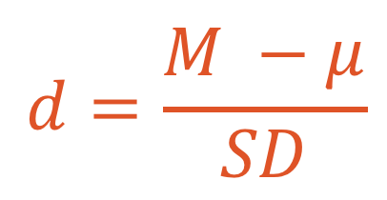
Compute an Effect Size and Describe it
5
One of the main effect size estimates is Cohen’s d
$$d=\frac{M −μ}{SD}$$
d | Estimated Size of the Effect
Close to .2 | Small
Close to .5 | Moderate
Close to .8 | Large

Slide 26
Interpreting the results
6
Put your results into words
Use the example on page 216 as a template

Slide 27
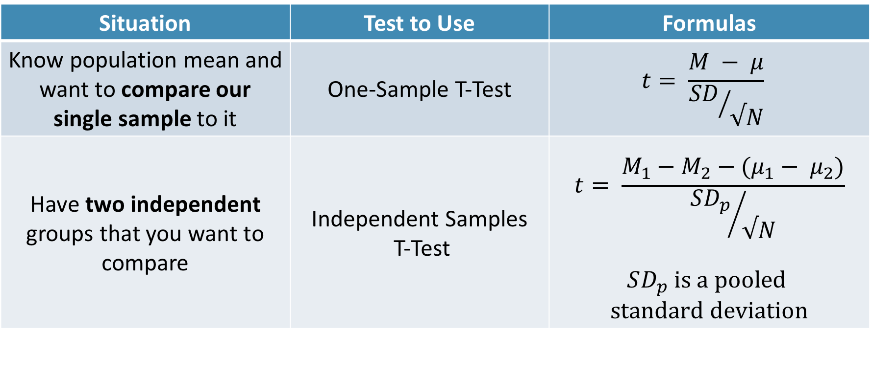
Independent Samples t-test vs One-Sample t-test
Situation | Test to Use | Formulas
Know population mean and want to compare our single sample to it | One-Sample T-Test | $$t= \frac{M − μ}{{SD}/{√N}}$$
Have two independent groups that you want to compare | Independent Samples T-Test | $$t= \frac{M_{1}−M_{2}−(μ_{1}− μ_{2})}{{SD_{p}}/{√N}}$$ $$SD_{p} is a pooled$$ $$standard deviation$$

Slide 28
Still using the same t-distribution
Notes:
As your sample size increases, the t gets closer and closer to the normal distribution

Slide 29
Requirements
ID | Outcome | Group
1 | 8 | 1
2 | 8 | 1
3 | 9 | 1
4 | 7 | 1
5 | 7 | 2
6 | 9 | 2
7 | 5 | 2
8 | 5 | 2
Need a DV on an interval/ratio scale,
IV defines two different groups
The groups are independent (not repeated measures)

Slide 30
Hypothesis Testing with T-Tests
The same 6 step approach!
Examine Variables to Assess Statistical Assumptions
State the Null and Research Hypotheses (symbolically and verbally)
Define Critical Regions
Compute the Test Statistic
Compute an Effect Size and Describe it
Interpreting the results

Slide 31
Examine Variables to Assess Statistical Assumptions
1
Basic Assumptions
Independence of data
Appropriate measurement of variables for the analysis
Normality of distributions
Homogeneity of variance

Slide 32
Examine Variables to Assess Statistical Assumptions
1
Basic Assumptions
Independence of data
Appropriate measurement of variables for the analysis
Normality of distributions
Homogeneity of variance
Individuals are independent of each other (one person’s scores does not affect another’s)

Slide 33
Examine Variables to Assess Statistical Assumptions
1
Basic Assumptions
Independence of data
Appropriate measurement of variables for the analysis
Normality of distributions
Homogeneity of variance
Here we need interval/ratio DV and an IV defines two groups
Notes:
For t-test, DV needs to be interval/ratio

Slide 34
Examine Variables to Assess Statistical Assumptions
1
Basic Assumptions
Independence of data
Appropriate measurement of variables for the analysis
Normality of distributions
Homogeneity of variance
The outcome needs to be normal (for small samples)

Slide 35
Examine Variables to Assess Statistical Assumptions
1
Basic Assumptions
Independence of data
Appropriate measurement of variables for the analysis
Normality of distributions
Homogeneity of variance
The variances of the two groups should be equal (although we can handle not equality)

Slide 36
Examine Variables to Assess Statistical Assumptions
1
Examining the Basic Assumptions
Independence: random sample
Appropriate measurement: know what your variables are
Normality: Histograms, skew and kurtosis
Homogeneity: Levene’s Test

Slide 37
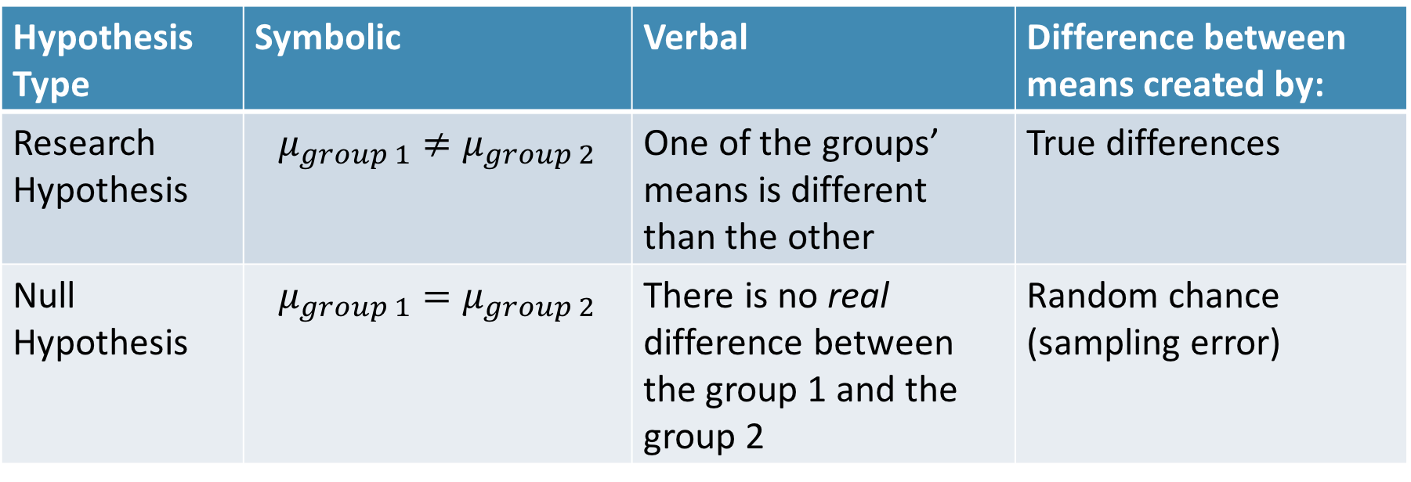
State the Null and Research Hypotheses (symbolically and verbally)
2
Hypothesis Type | Symbolic | Verbal | Difference between means created by:
Research Hypothesis | $$μ_{group 1}≠μ_{group 2}$$ | One of the groups’ means is different than the other | True differences
Null Hypothesis | $$μ_{group 1}=μ_{group 2}$$ | There is no real difference between the group 1 and the group 2 | Random chance (sampling error)
Notes:
Null and research hypotheses are mutually exclusive (they cover all possible outcomes)

Slide 38
Define Critical Regions
3
How much evidence is enough to believe the null is not true?
Before analyzing the data, we define the critical regions (generally based on an alpha = .05)

Slide 39
Define Critical Regions
3
We decide on an alpha level first
Then calculate the critical value (based on sample size)

Slide 40
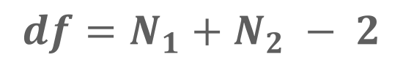
Define Critical Regions
3
We decide on an alpha level first
Then calculate the critical value (based on sample size)
I’ll provide a table for you for the t values
Base on alpha and a specific df
$$df=N_{1}+N_{2} − 2$$
Notes:
If our computed t value is beyond 2.05 OR our p-value is below .05, then we REJECT the null (the findings are statistically significant)

Slide 41
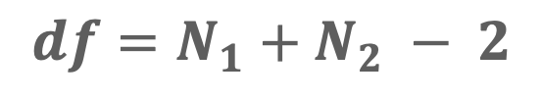
Define Critical Regions
3
We decide on an alpha level first
Then calculate the critical value (based on sample size)
I’ll provide a table for you for the t values
Base on alpha and a specific df
$$df=N_{1}+N_{2} − 2$$
Notes:
If our computed t value is beyond 2.05 OR our p-value is below .05, then we REJECT the null (the findings are statistically significant)

Slide 42
Define Critical Regions
3
We decide on an alpha level first
Then calculate the critical value (based on sample size)
$$t_{critical, 29}=2.05$$
So our critical regions is defined as:
$$α= .05$$
$$t_{critical, 29}=2.05$$
Notes:
If our computed t value is beyond 2.05 OR our p-value is below .05, then we REJECT the null (the findings are statistically significant)

Slide 43
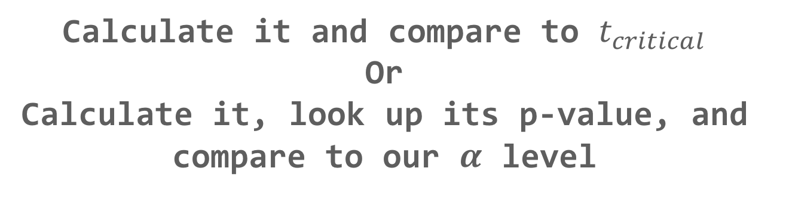
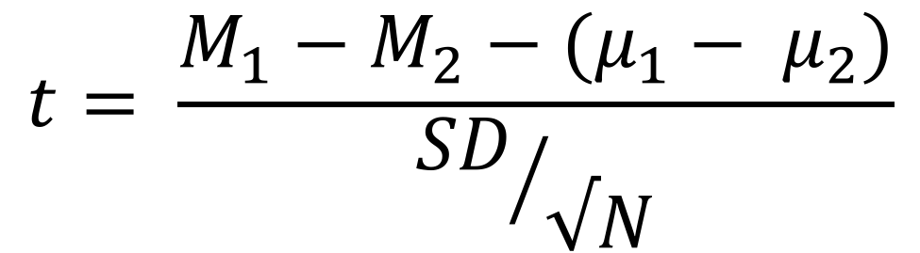
Compute the Test Statistic
4
$$t= \frac{M_{1}−M_{2}−(μ_{1}− μ_{2})}{{SD}/{√N}}$$
The SEM, $μ$, and M will be given to you
Calculate it and compare to $t_{critical}$
Or
Calculate it, look up its p-value, and compare to our $α$ level

Slide 44
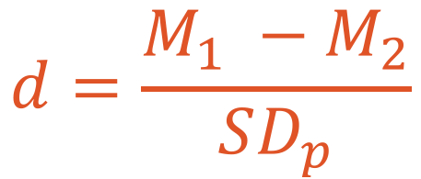
Compute an Effect Size and Describe it
5
One of the main effect size estimates is Cohen’s d
$$d=\frac{M_{1} −M_{2}}{SD_{p}}$$
d | Estimated Size of the Effect
Close to .2 | Small
Close to .5 | Moderate
Close to .8 | Large

Slide 45
Interpreting the results
6
Put your results into words
Use the example on page XX as a template

Slide 46
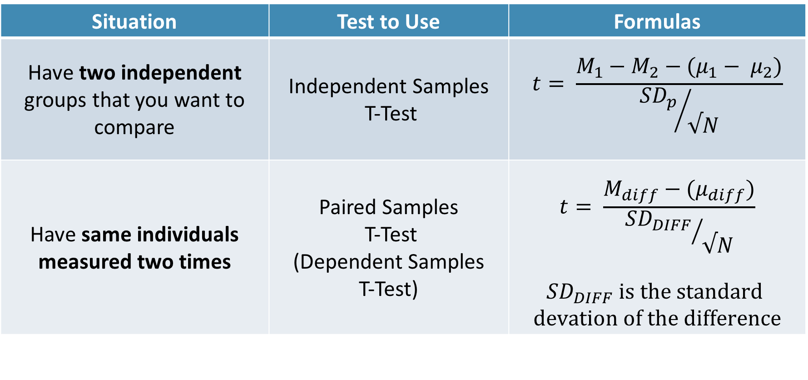
Paired Samples T-test
Situation | Test to Use | Formulas
Have two independent groups that you want to compare | Independent Samples T-Test | $$t= \frac{M_{1}−M_{2}−(μ_{1}− μ_{2})}{{SD_{p}}/{√N}}$$
Have same individuals measured two times | Paired Samples T-Test (Dependent Samples T-Test) | $$t= \frac{M_{diff}−(μ_{diff})}{{SD_{DIFF}}/{√N}}$$ $$SD_{DIFF} is the standard$$ $$devation of the difference$$

Slide 47
Requirements
ID | Time 1 | Time 2
1 | 8 | 7
2 | 8 | 8
3 | 9 | 6
4 | 7 | 6
5 | 7 | 8
6 | 9 | 5
7 | 5 | 3
8 | 5 | 3
Need a DV on an interval/ratio scale,
IV defines two time points
Same individuals measured twice

Slide 48
Examine Variables to Assess Statistical Assumptions
1
Basic Assumptions
Independence of data
Appropriate measurement of variables for the analysis
Normality of distributions
Homogeneity of variance

Slide 49
Examine Variables to Assess Statistical Assumptions
1
Basic Assumptions
Independence of data
Appropriate measurement of variables for the analysis
Normality of distributions
Homogeneity of variance
Individuals are independent of each other (one person’s scores does not affect another’s)

Slide 50
Examine Variables to Assess Statistical Assumptions
1
Basic Assumptions
Independence of data
Appropriate measurement of variables for the analysis
Normality of distributions
Homogeneity of variance
Here we need two interval/ratio DVs (one for each time point)
Notes:
For t-test, DV needs to be interval/ratio

Slide 51
Examine Variables to Assess Statistical Assumptions
1
Basic Assumptions
Independence of data
Appropriate measurement of variables for the analysis
Normality of distributions
Homogeneity of variance
The outcome needs to be normal (for small samples)

Slide 52
Examine Variables to Assess Statistical Assumptions
1
Basic Assumptions
Independence of data
Appropriate measurement of variables for the analysis
Normality of distributions
Homogeneity of variance
The variances of the two time points should be equal

Slide 53
Examine Variables to Assess Statistical Assumptions
1
Examining the Basic Assumptions
Independence: random sample
Appropriate measurement: know what your variables are
Normality: Histograms, skew and kurtosis
Homogeneity: Levene’s Test

Slide 54
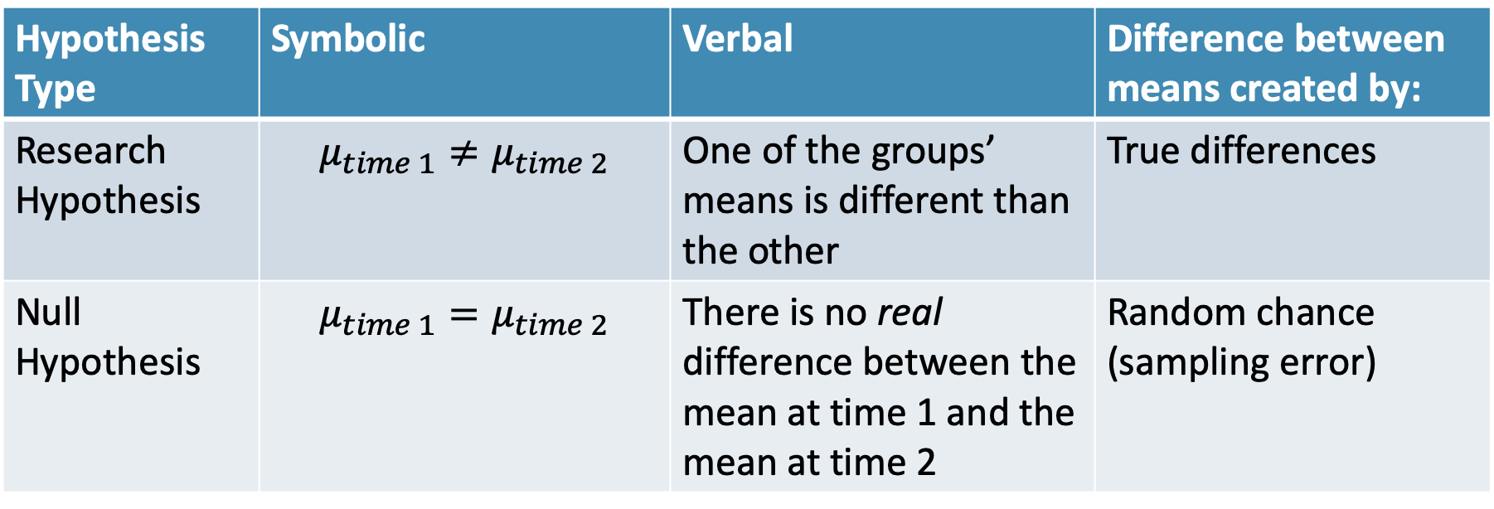
State the Null and Research Hypotheses (symbolically and verbally)
2
Hypothesis Type | Symbolic | Verbal | Difference between means created by:
Research Hypothesis | $$μ_{time 1}≠μ_{time 2}$$ | One of the groups’ means is different than the other | True differences
Null Hypothesis | $$μ_{time 1}=μ_{time 2}$$ | There is no real difference between the mean at time 1 and the mean at time 2 | Random chance (sampling error)
Notes:
Null and research hypotheses are mutually exclusive (they cover all possible outcomes)

Slide 55
Define Critical Regions
3
How much evidence is enough to believe the null is not true?
Before analyzing the data, we define the critical regions (generally based on an alpha = .05)

Slide 56
Define Critical Regions
3
We decide on an alpha level first
Then calculate the critical value (based on sample size)

Slide 57

Define Critical Regions
3
We decide on an alpha level first
Then calculate the critical value (based on sample size)
I’ll provide a table for you for the t values
Base on alpha and a specific df
$$df=N_{diff}−1$$
57
Notes:
If our computed t value is beyond 2.05 OR our p-value is below .05, then we REJECT the null (the findings are statistically significant)

Slide 58
Define Critical Regions
3
We decide on an alpha level first
Then calculate the critical value (based on sample size)
$$t_{critical, 29}=2.05$$
So our critical regions is defined as:
$$α= .05$$
$$t_{critical, 29}=2.05$$
Notes:
If our computed t value is beyond 2.05 OR our p-value is below .05, then we REJECT the null (the findings are statistically significant)

Slide 59
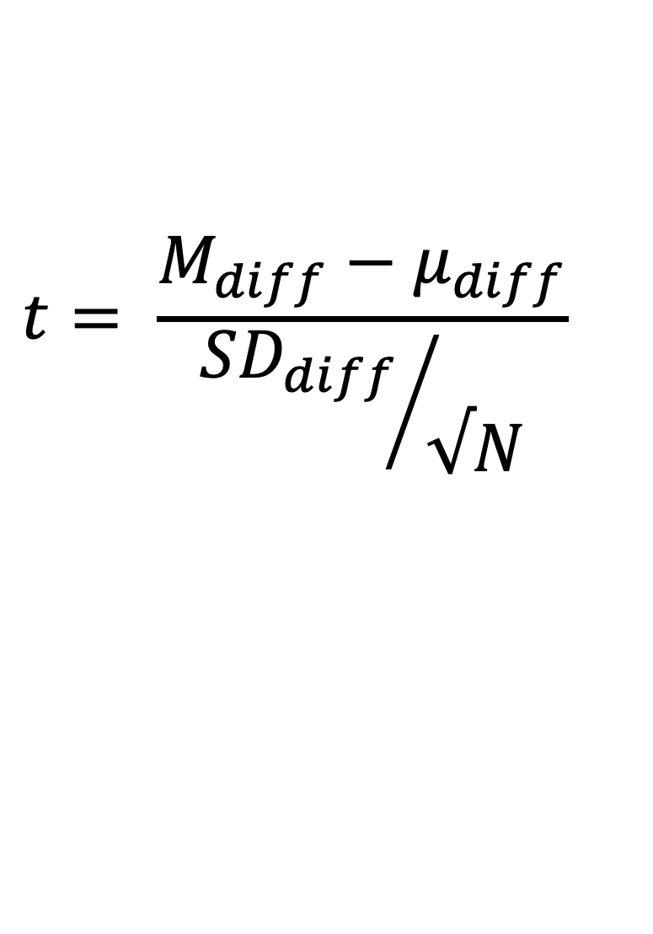
Compute the Test Statistic
4
$$t= \frac{M_{diff}−μ_{diff}}{{SD_{diff}}/{√N}}$$
Calculate it and compare to $t_{critical}$
Or
Calculate it, look up its p-value, and compare to our $α$ level

Slide 60
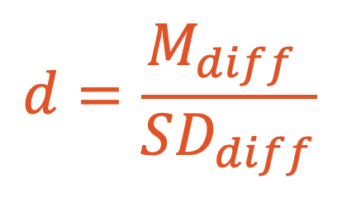
Compute an Effect Size and Describe it
5
One of the main effect size estimates is Cohen’s d
$$d=\frac{M_{diff} }{SD_{diff}}$$
d | Estimated Size of the Effect
Close to .2 | Small
Close to .5 | Moderate
Close to .8 | Large

Slide 61
Interpreting the results
6
Put your results into words

Slide 62
Questions?
Please post them to the discussion board before class starts
End of Pre-Recorded Lecture Slides

Slide 63
In-class discussion
slides

Slide 64
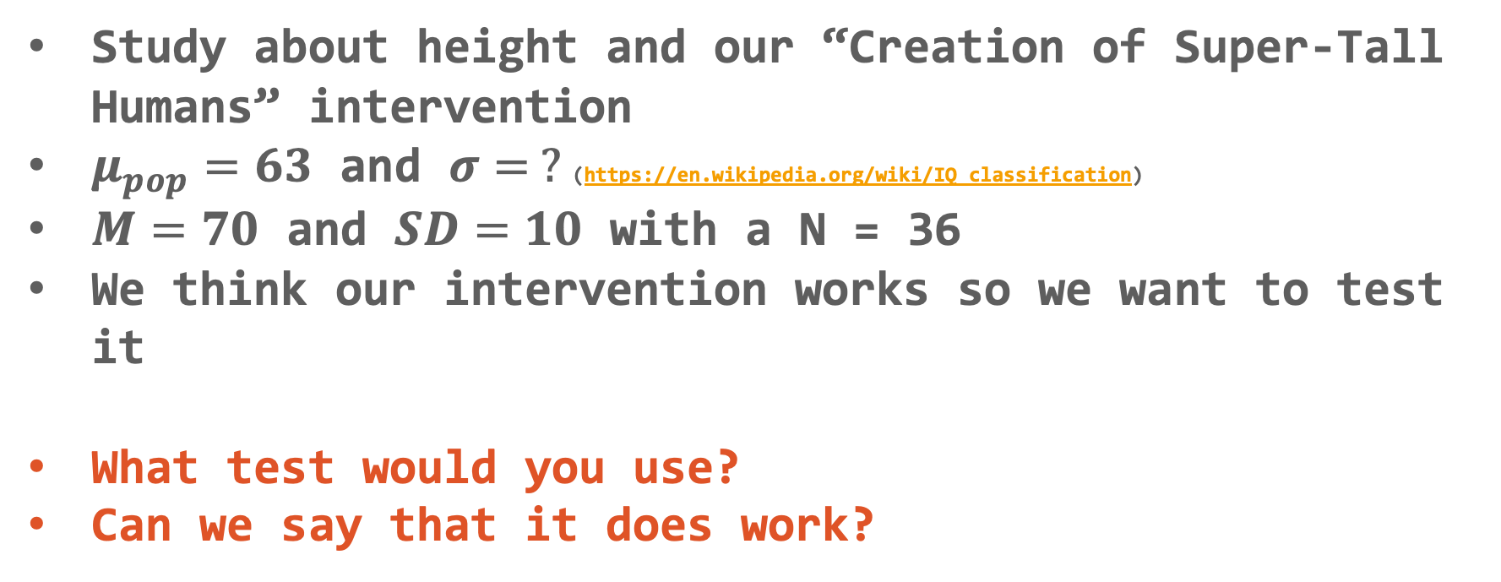
Hypothesis Testing with T-tests
Let’s practice!
Study about height and our “Creation of Super-Tall Humans” intervention
$μ_{pop}=63$ and $σ= ?$(https://en.wikipedia.org/wiki/IQ_classification)
$M=70$ and $SD=10$ with a N = 36
We think our intervention works so we want to test it
What test would you use?
Can we say that it does work?

Slide 65
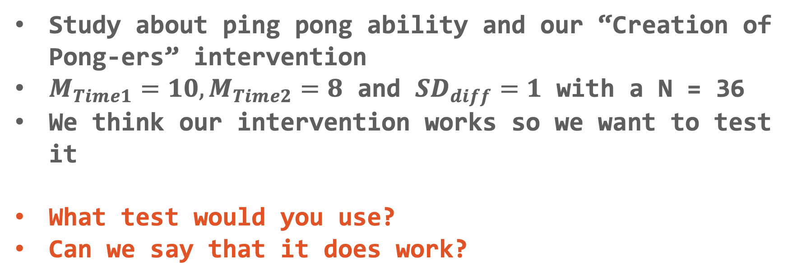
Hypothesis Testing with T-tests
Let’s practice!
Study about ping pong ability and our “Creation of Pong-ers” intervention
$M_{Time1}=10, M_{Time2}=8$ and $SD_{diff}=1$ with a N = 36
We think our intervention works so we want to test it
What test would you use?
Can we say that it does work?

Slide 66
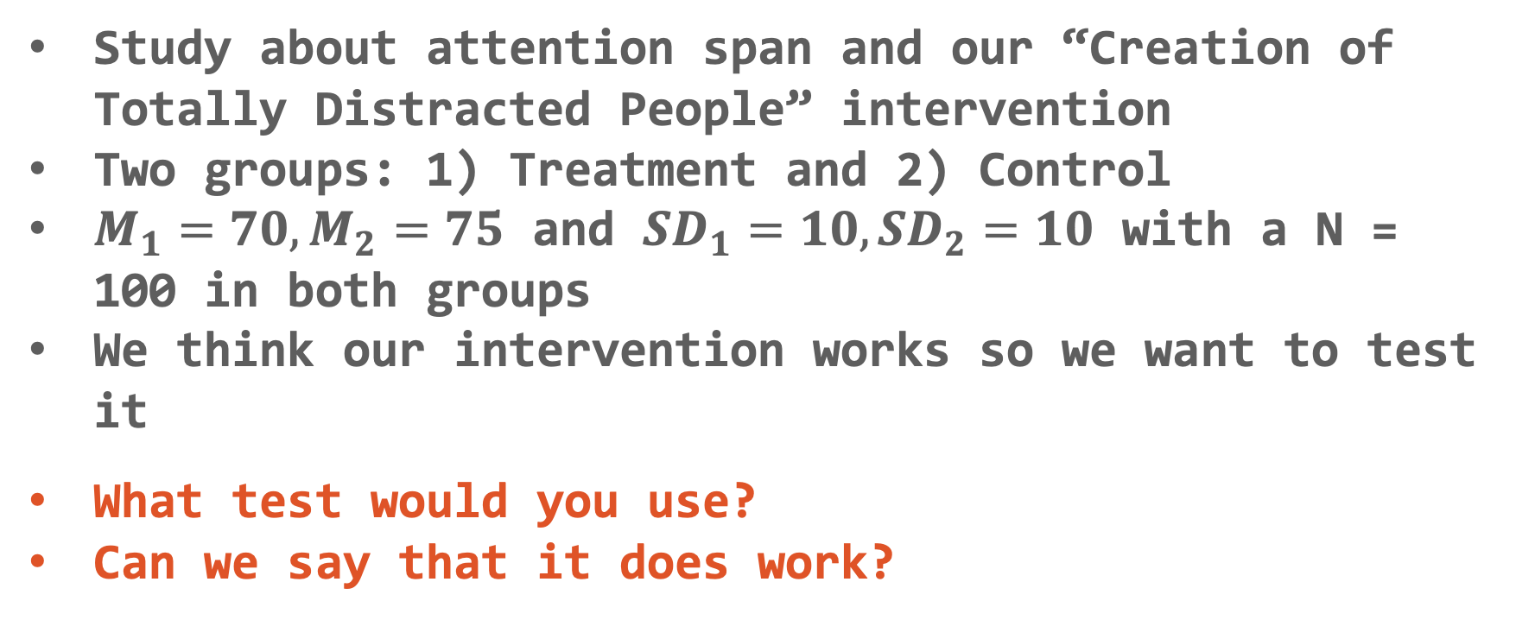
Hypothesis Testing with T-tests
Let’s practice!
Study about attention span and our “Creation of Totally Distracted People” intervention
Two groups: 1) Treatment and 2) Control
$M_{1}=70, M_{2}=75$ and $SD_{1}=10, SD_{2}=10$ with a N = 100 in both groups
We think our intervention works so we want to test it
What test would you use?
Can we say that it does work?

Slide 67
Hypothesis Testing Rules
We make a handful of decisions along this process
Alpha level
Research and Null Hypotheses
These are related to Type I and Type II errors
Notes:
Alpha level is the chance of a Type I error
Make it smaller (e.g., .01) then Type I error decreases, but Type II error increases
Two-tailed tests are more conservative than one-tailed tests (let’s stick with two-tailed)

Slide 68
Reject that Null!
We don’t accept either the research or null hypotheses
Rather it is either evidence for or against the null
We do say that we “reject” or “fail to reject” the null

Slide 69
What is a p-value?
The probability of getting an obtained value or a more extreme value assuming the null is true
Whether results are due to chance (sampling error)
Page 163

Slide 70
Evidence vs. Proof
Since we use p-values, there is always a chance that we made a Type I or Type II error
So we have evidence for or against it but we do NOT have PROOF of the research or null hypotheses
I like the discussion on Page 165 about this

Slide 71
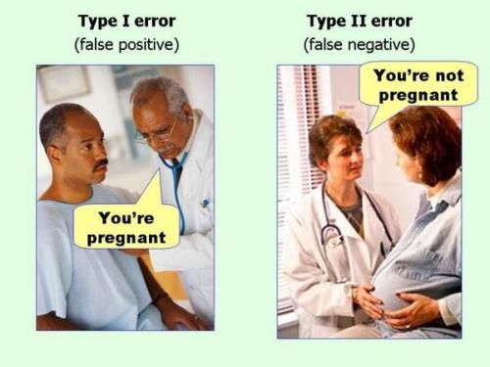
Errors in Hypothesis Testing (any type)
Notes:
Which is more dangerous in your field?

Slide 72
Confidence Intervals
CI
Theory Behind It

Slide 73

Confidence Intervals
CI
How we use it
Our Estimate
Lower Bound
Upper Bound
$$Estimate±t_{critical}∗SE_{est}$$

Slide 74
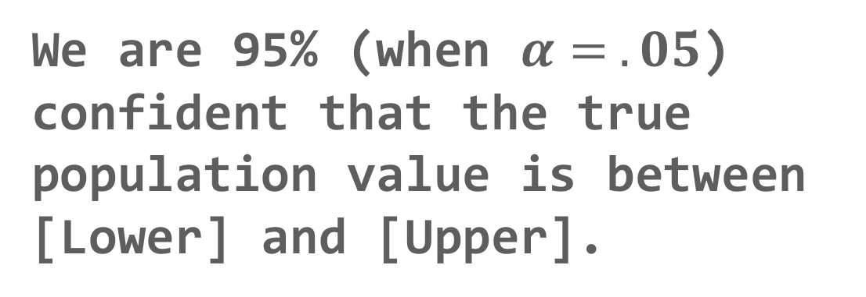
Confidence Intervals
CI
Our Estimate
Lower Bound
Upper Bound
We are 95% (when $α= .05$) confident that the true population value is between [Lower] and [Upper].
Interpretation:

Slide 75
Application
Example Using the Class Data &
The Office/Parks and Rec Data Set
Full Hypothesis Test Example
(t-tests)

